Slide 1
Sudoku
Design and implementation
Software Engineer: Dzianis Markhotka

Slide 2
Tasks:
Part 1
Write a program that reads a Sudoku from a normal text file. The text file should be build by 9 rows with 9 characters each followed by an End of Line char. Each character is either a number (1-9) or some other character to symbolize an empty box. Store the read Sudoku in a suitable data structure.
Part 2
Write an algorithm that solves the Sudoku and verifies that there is only one solution and presents it in some way (can be a console printout or a windows form). Create some way of classifying the level of difficulty of the Sudoku (see the 4 attached examples)
Part 3
Implement an algorithm that creates a Sudoku with a unique solution.
Part 4
Add a simple User Interface for managing the above features.

Slide 3
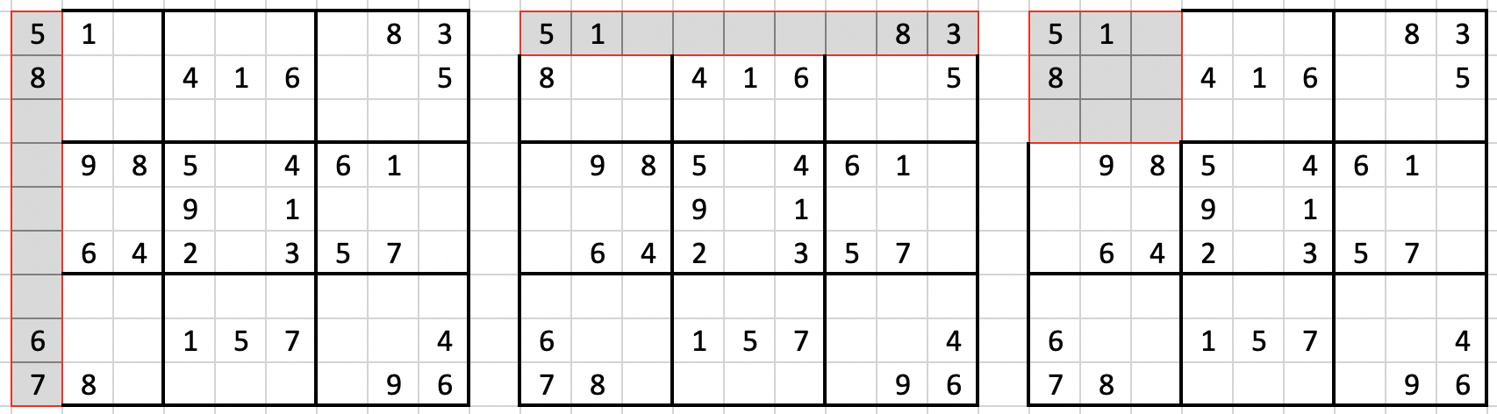
Rules
Unique numbers in each segments

Slide 4
Data structure:

Slide 5
Sequences of the steps to solve the assignment:
Implement sudoku solving algorithm
Implement sudoku generating algorithm
Design application
Implement UI

Slide 6
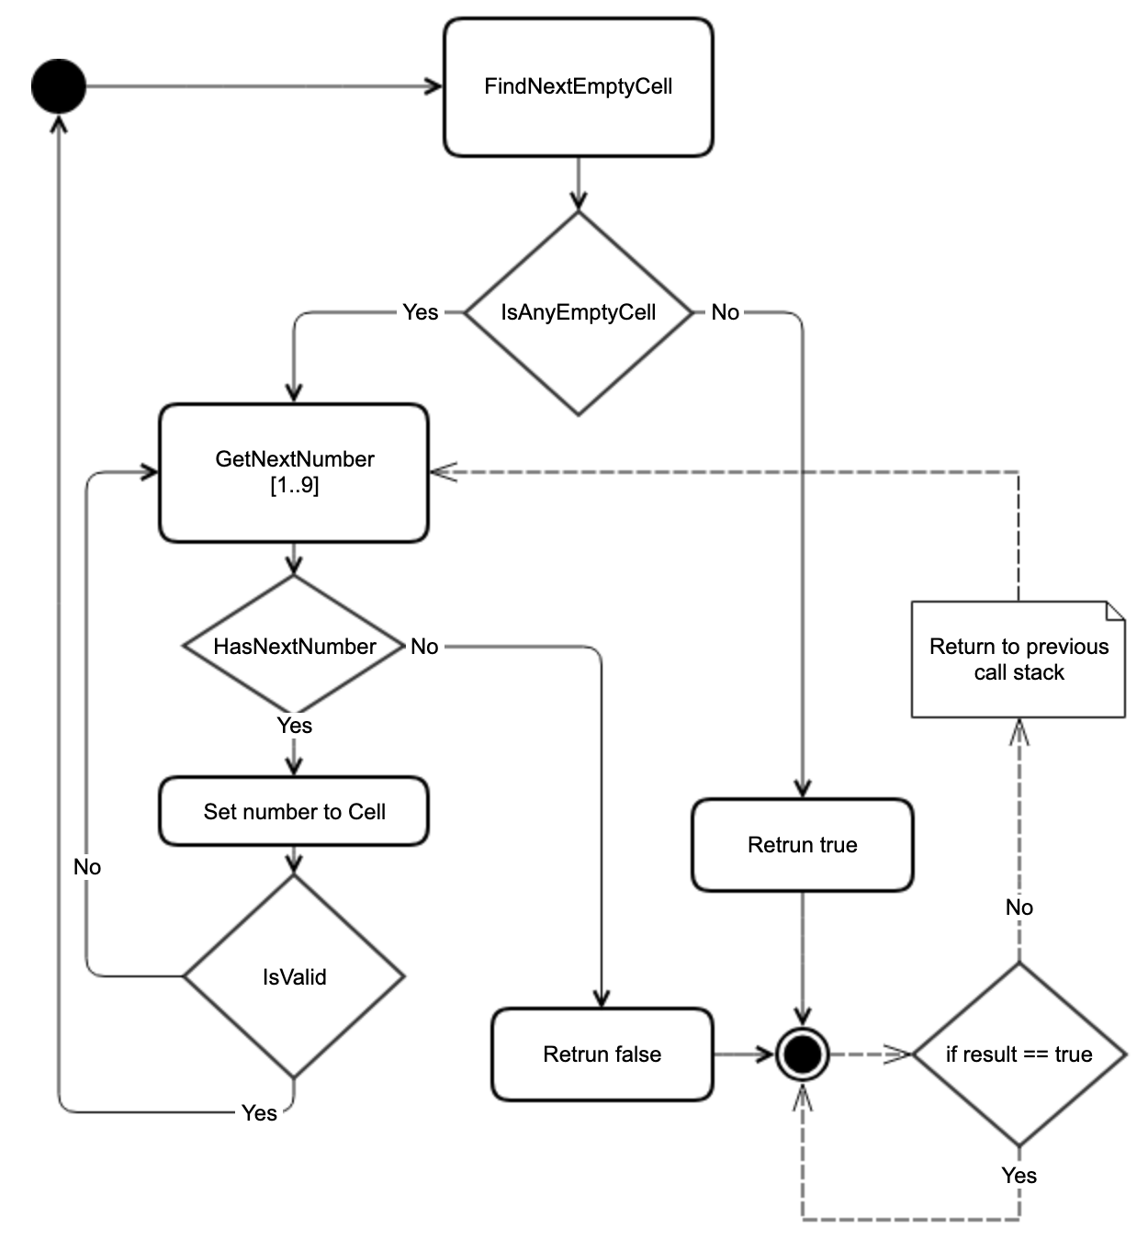
Brute-force search algorithm:

Slide 7
Optimization of the algorithm and problems solving
Optimize function of “FindNextCell”
Solve unique solution problem

Slide 8
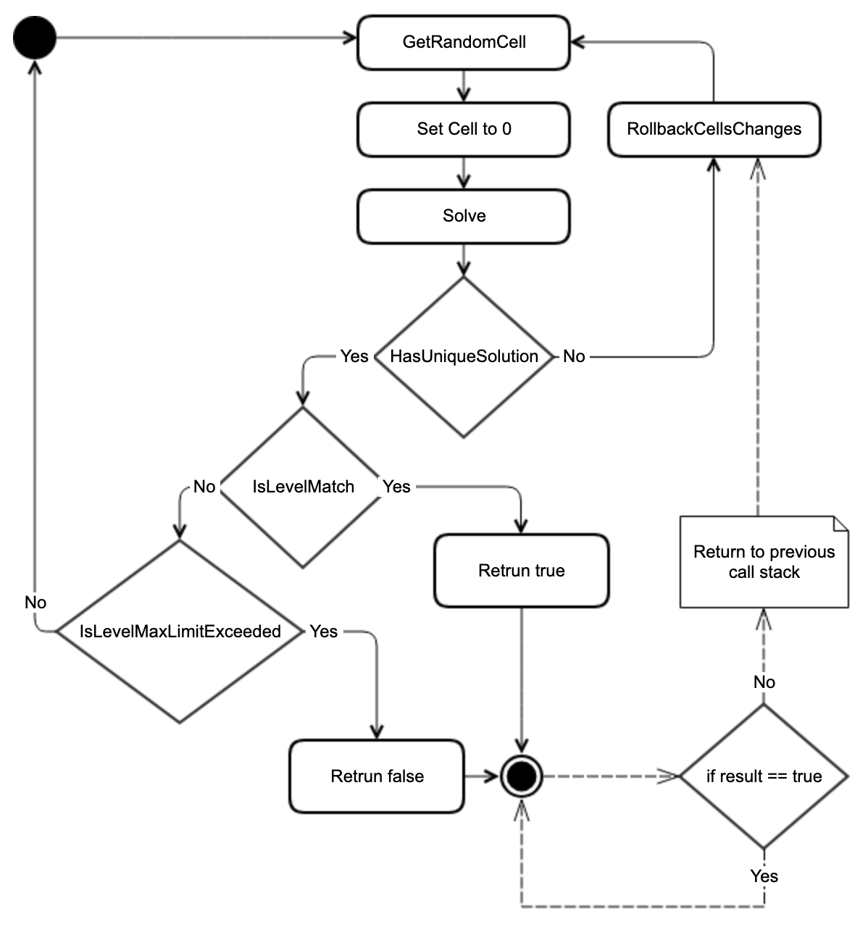
Algorithm of Sudoku generating

Slide 9
Rank the difficulty

Slide 10
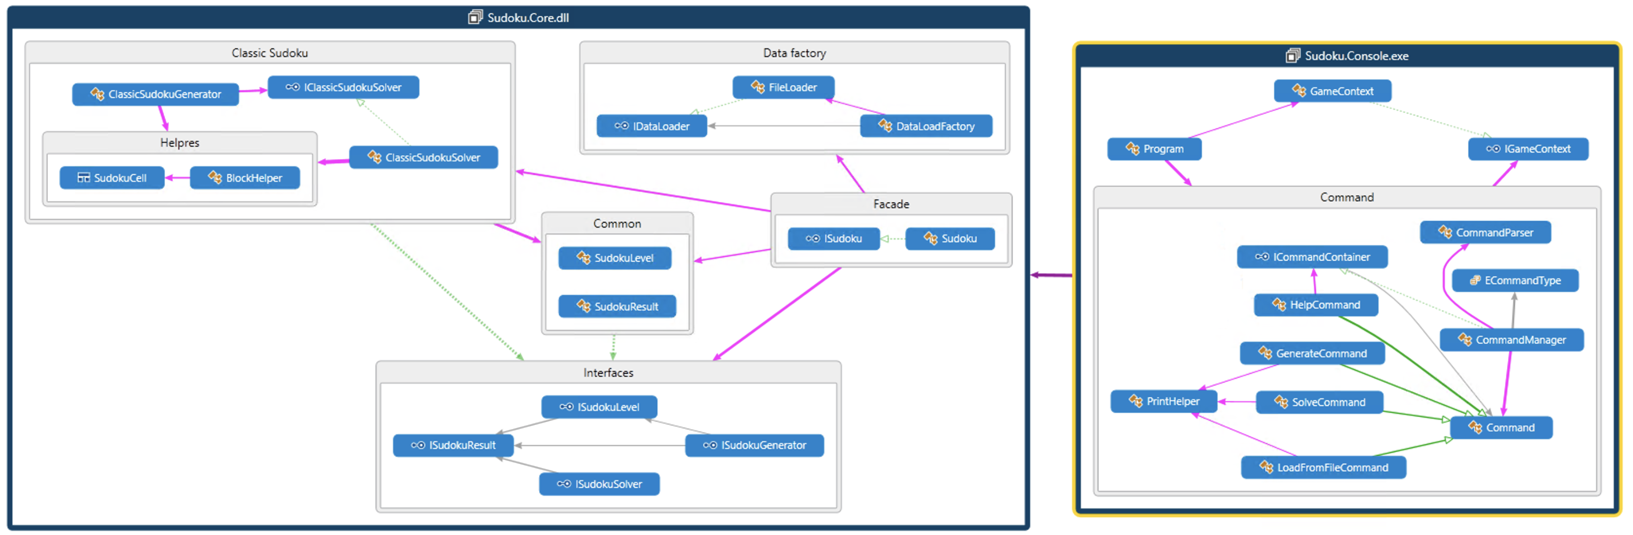
Design

Slide 11
User Interface
Online demonstration

Slide 12
Any questions?

